Slide 1

Emotions are Data
Understanding and Harnessing
our Emotional Signals
Nori Morita
July, 2025

Slide 2

In this Lesson You’ll:
1. Appraise three of the human brain’s layers
2. Weigh how emotions affect us in our daily lives
3. Investigate emotional signals
4. Design responses rather than allowing reactions
to make personal accountability easier

Slide 3

Spark

Slide 4
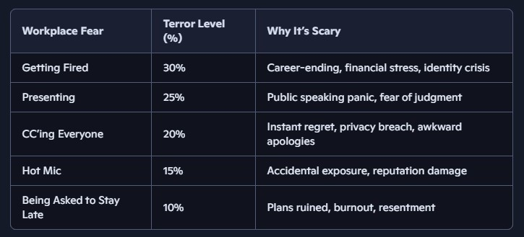
Top Five Scariest Things that can Happen at Work
Do any of these events resonate with you?
According to vault.com, experiencing any of these events might cause you to fight the boss, fly away home, freeze in your cubicle or even appease the threat to avoid harm. It all depends on who you are, your past experiences and what’s at stake.
In this lesson, registered psychotherapist Natacha Duke, MA, RP, and others help us understand how different stress responses manifest and how you can best manage them.

Slide 5

Spark 1 (Review): Stress & Pressure
Try this Sorting Activity to group these statements into the correct category.
PRESSURE
Is external
Includes demands and expectations
Considers levels of risk & reward.
Is experienced by most of us in general situations
STRESS
Is internal
Includes personal fears, anxiety and doubts
Is increased by lack of security
Makes us feel overwhelmed.
Is experienced in uniquely personal situations
Refer to lesson 32 for a more detailed explanation.
Notes:
Shawna and Courtney - maybe use a Question Bank Block or Sorting Activity Block
Facilitator uses this slide as Key to guide discussion
Then, Ask learner to complete this simple task:
“For you, was this information:
1 New?
2 Old, but presented in a new way?
3 A good reminder?”
Can be used for learner’s self-tracking progress.

Slide 6
Spark 1: Lived Experience
The author of this lesson once worked in a Japanese oil refinery with a team of international advisors. After an Australian colleague had an unexpected issue with his work permit and had to suddenly leave/re-enter Japan to obtain a working visa to which the permit could be applied, he scolded his Japanese colleague, shouting, “This is all your fault! Don’t you want me to work here?!” The Japanese staffer had merely – and correctly - followed permit protocol. While the Australian was red in the face and held an intense stare, his Japanese counterpart (who had completed his task correctly) avoided eye contact, maintained a calm voice and apologized, saying “ I am very sorry – it won’t happen again.”
What emotions can you identify from this exchange? What emotions may be present but not observable? List them in your notes or discuss with a partner.
How do you think the relationship between these colleagues has changed because of this outburst?
If in a group, please share your experiences and show how emotions can charge situations

Slide 7
“Emotions are not the problem—they're information.
Learning to use them leads to better decisions.”
Notes:
Perhaps use a Quote Block here.

Slide 8
Emotional Data Checklist (Pre)
How adept are you at recognizing your colleagues’ emotional signals? Try the quiz on the next slide to match emotions with observable visual and spoken expressions to see how well you can perceive ‘feeling data.’
This is not a ‘pass or fail’ type of quiz.
At the end of this lesson, you’ll have a chance to retake this quiz to compare your progress.
Notes:
Shawna and Courtney, please use a sorting block for the following: Emotional Expressions - Visual and Verbal by Geography.xls

Slide 9
Emotional Data Checklist (Pre) KEY
Identity | Physical Features | Vocal Features
Angry Brazilian | Frowning; direct eye contact; tense jaw, hand gestures | Raised, loud, passionate
Angry Chinese | Face neutral or slightly tight mouth | Quiet and firm, cold, clipped cadence
Confused Japanese | Nods politely, may ask questions later | Polite and respectful, pausing before speaking
Confused West African | Subtle gesture or questioning look, hesitant to interrupt | Quiet, polite tone.
Disappointed Phillipino | Sad eyes, polite smile | Quiet and resigned
Disappointed Western European | Frown and/or downcast eyes | Serious, somber tone
Disappointed South Asian | Sad expression, and a solemn look | Quiet and somber; a sigh
Loyal Israeli | Serious | Strong, maybe aggressive, very direct tone
Loyal Chinese | Unchanging expression, serious | Firm, respectful, and serious tone
Mentally Fatigued Mexican | Slumped posture, rubbing the eyes or temples | Sighs, a slow and tired voice
Mentally Fatigued South Korean | Tired smile, slightly slumped posture | Quiet and tired voice
Menatally Fatigued West African | Yawns, rubbing eyes, or a deep sigh. | Tired, slow, slightly slurred speech
Proud Brazillian | Open, beaming smile; posture is upright and confident, may 'high-five' people | Loud, enthusiastic, and confident tone
Proud Muslim Middle Easterner or Iranian | Broad smile, confident posture; can be very expressive | Warm, but not very assertive tone
Proud North American (East Coast) | Open, confident smile, upright posture; direct eye contact | Confident, assertive, enthusiastic tone
Stressed Colombian | Frowning; tense posture, quickened pace | Quick, sometimes shaky or frustrated tone
Stressed South Korean | Hunched back, hurried pace, serious expression | Hurried, often quiet, serious tone
Stressed Western European | Fidgeting, sighing, or a tired, strained look | Sighing, tense, maybe frustrated tone
Notes:
Shawna and Courtney, please use a sorting block for the following: Emotional Expressions - Visual and Verbal by Geography.xls
The two physical and verbal features can be kept together in the same row to cerate the simples form of mix and match activity.

Slide 10
Spark 2: Meet the Brain
Reflection Activity:
Have you ever felt uncomfortable at work because of what you thought other people might be saying about you or doing something to prevent you from reaching a goal? Note the situation down.
Maybe you were being, judged, rejected, or felt inadequate.
Note your feelings down. It’s okay if these feelings were unpleasant.
Notes:
SPARK 1:
Reflection Activity: Have you ever felt uncomfortable at work because of what you thought other people might be saying about you or doing to prevent you from reaching a goal?
Maybe you were being, judged, rejected, or felt inadequate
Note the situation down.
Now
Note your ideas down and a couple of examples of what makes you feel pressure and stress before advancing the slide.
If in a group setting, please discuss with other learners and your facilitator

Slide 11
Spark 2: Meet the Brain
Reflection Activity:
In the next slide, psychologist Dr. Russ Harris explains why our minds will tend to ‘default’ to negative thinking about some of life’s situations.
Notes:
SPARK 1:
Reflection Activity: Have you ever felt uncomfortable at work because of what you thought other people might be saying about you or doing to prevent you from reaching a goal?
Maybe you were being, judged, rejected, or felt inadequate
Note the situation down.
Now
Note your ideas down and a couple of examples of what makes you feel pressure and stress before advancing the slide.
If in a group setting, please discuss with other learners and your facilitator

Slide 12
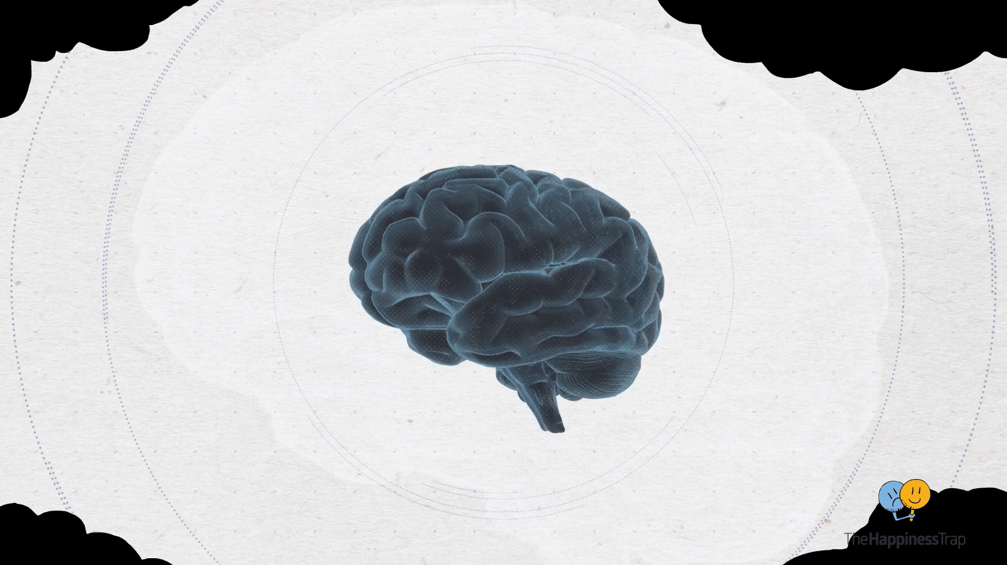
Notes:
https://www.youtube.com/watch?v=kv6HkipQcfA

Slide 13
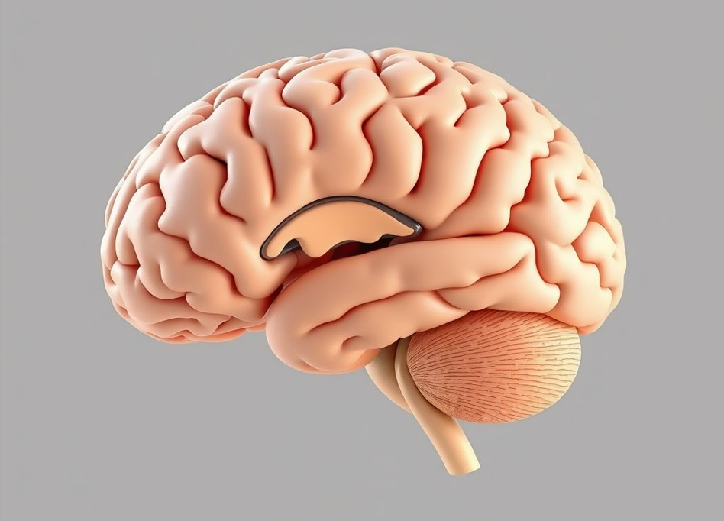
Science can help explain both our emotional and physical reaction to pressure and stress, which is embedded in our genes. As you’ve seen, all animals -including humans- have a built-in survival mechanism that ‘kicks in’ when our brains perceive danger in our environment.

Slide 14
Neo Cortex “Human Brain”
Responsible for memory, learning, conscious thought, decision making, planning, voluntary movement, reasoning, language, higher-level thinking. It’s the most developed part of our brain and is what separates us from other mammals.
Limbic System “Mammal Brain”
Responsible for emotions and the formation of habits and new memories based on recent experiences.
Brain Stem “Reptile Brain”
Responsible for the regulation of heart rate, breathing, sleeping, and eating. It coordinates the flow of information between the body and other parts of the brain. It triggers the ‘fight, flight or freeze’ response.
Notes:
Labelled Graphic BLock

Slide 15
Shift

Slide 16

Shift 1: What Goes on in Your Mind?
The author of this lesson once taught emotional restraint techniques to a mother of three. One day she was taking her daughter along to the car dealership where she was expecting some typically strong pushback from the dealer regarding her warranty (again!). Her seven-year-old daughter, who had accompanied Mom in the past and enjoyed all the antics, was expecting a no-holds-barred fight between her Mom and ‘the man in the parking lot.’ To her dismay – and her mother’s quiet pride – there was no shouting match, or even an argument! The mother used her ability to recognize rage, restrain her knee-jerk reaction and reroute to an agreeable reality (getting the service she was due, without payment). On the way home, her daughter was in turn disappointed, amazed, and then pensive.
Notes:
Shawna and Courtney, please see the updated Glossary for new info, thanks. -nm

Slide 17
Shift 1: What Goes on in Your Mind?
“I’m supposed to be calm, collected and confident. Sometimes I ignore how I’m feeling—but it shows up in my tone or body language.”
Perhaps you’ve seen someone have a ‘meltdown’ at work; maybe one of your stress triggers made you feel anxious or unable to express yourself clearly…
Note the situation and your feelings down.
Go to the next slide to see the emotional data collection process and possible results.

Slide 18
Shift 1:
Neo Cortex
3. The Neo Cortex is the thinking brain, so it considers the information. This takes 1/100 of a second, which is quick. But the amygdala does a very fast threat assessment to determine danger. It only takes 1/1000 of a second!
4. The amygdala blocks slow thinking. If it determines that there is danger, it blocks the Neo Cortex (slower, reasoning brain) and immediately triggers a danger reaction (‘fight, flight or freeze’ result) as part of the body’s survival programming. It’s a ‘non-thinking’ reaction.
2. The thalamus acts like a hub and instantly sends the information to both the amygdala (in the limbic system), and the Neo Cortex.
This non-thinking reaction is designed to keep you safe. It triggers a flood of ‘stress hormones’ like adrenaline (increasing your heart rate & blood pressure) and cortisol (increasing your energy). Your entire body is now on ‘high alert.’ Your Neo Cortex is not necessarily involved.
What situations at work might trigger this kind of reaction? How could our emotions express themselves if our amygdala overestimates the size of a threat? Note your ideas down.
Limbic System
1. Sensory triggers (e.g., sight, sound, taste, touch or pain) are feed to the thalamus in our limbic system

Slide 19

Shift 2: Emotional Reaction Implications
If our brains really are wired to think negatively, we might face more challenges if our ‘thinking brain’ is not involved in our response.
The non-thinking response is great if a stranger begins following you when you’re alone on a dark street, but what if you hear someone gossiping about you? Or if you’re suddenly asked to give a public speech? Or if a colleague dismisses you rudely?
List the implications of a non-thinking reaction you’ve had or witnessed at work.

Slide 20
Shift 2: Emotional Reaction Implications
We rarely come across situations in our lives that put us in real physical danger; most of the situations we perceive as ‘dangerous’ are merely related to fears or doubts – and are often about change.
How can you train yourself to let your neo cortex think through challenges and consider ‘possibilities’ so your survival or emotional (limbic) response doesn’t limit your ‘higher thinking’?
First, we want to avoid negative mindsets to overcome perceived fears and real anxieties. If we have a negative outlook and often think the ‘worst will happen’, we’re letting our amygdala ‘highjack’ our potential.
Reasoning and choosing to respond to a changing world instead of reacting plays a very important part of many skills in Workplace Edge – managing stress, resilience, emotional intelligence, and many more.
Notes:
Facilitator invites reflection and then discussion with other learners. Could offer the following utterances to prompt discussion, “How might using these phrases help defuse some situations?
“I want to check my assumptions before reacting.”
“Let’s talk again once I’ve had time to reflect.”
Questions to ask yourself”:
Am I catastrophizing? What are the facts?
Am I catastrophizing? What emotions am I feeling now?
Am I catastrophizing? What can I actually control here?
Is this an amygdala hijack? Do I need to practice deep breathing?

Slide 21
Shift 2: Emotional Reaction Implications
How might using these phrases help defuse some situations?
  “I want to check my assumptions before reacting.”
  “Let’s talk again once I’ve had time to reflect.”
  Also, ask yourself:
  Am I catastrophizing? What are the facts?
  Am I catastrophizing? What specific emotions am I feeling now?
  Am I catastrophizing? What can I actually control here?
  Is this an amygdala hijack? Do I need to practice deep breathing?
Notes:
Facilitator invites reflection and then discussion with other learners. Could offer the following utterances to prompt discussion, “How might using these phrases help defuse some situations?
“I want to check my assumptions before reacting.”
“Let’s talk again once I’ve had time to reflect.”
Questions to ask yourself”:
Am I catastrophizing? What are the facts?
Am I catastrophizing? What emotions am I feeling now?
Am I catastrophizing? What can I actually control here?
Is this an amygdala hijack? Do I need to practice deep breathing?

Slide 22
Shift 3: Emotions & Personal Accountability
Choosing to respond to challenging situations instead of reacting can lead to praise and recognition. On the other hand, emotional outbursts and reactions can limit our opportunities.
Emotions just ‘happen’ and can be very complex. They can sometimes lead to unintended –and unpleasant- consequences. If we let some emotions drive our actions, we may be held accountable for them. Other emotions furnish great outcomes and, of course, we enjoy taking responsibility for them.
So, what’s the difference between responsibility and accountability?

Slide 23
Shift 3: Emotions & Personal Accountability
Use this sorting activity to match the characteristics under Responsibility or Accountability at work:
RESPONSIBILITY
Is voluntary
Does not often involve emotions
Can be delegated
Happens before actions or events (usually)
Appears in job descriptions
Is not usually difficult to assume
Is experienced by almost everyone
ACCOUNTABILITY
Is voluntary
May involve emotions
Cannot be delegated
Happens after actions or events (usually)
Does not appear in job descriptions
Can be difficult to admit
Is not necessarily experienced by everyone
Notes:
Use a sorting activity block to match the characteristics under Responsibility or Accountability
RESPOSNIBILITY
Is voluntary
Is not usually linked to emotions
Can be delegated
Happens before actions or events (usually)
Appears in job descriptions
Is not usually difficult to assume
Experienced by almost everyone
ACCOUNTABILITY
Is voluntary
Is not sometimes/often? linked to emotions
Cannot be delegated
Happens after actions or events (usually)
Does not appear in job descriptions
Can be difficult to admit
Not necessarily experienced by everyone

Slide 24
Stretch

Slide 25
Stretch 1: How is Emotional Expression Handled in your Workplace?
Do you notice colleagues building personal relationships as well as being task oriented?
Or do people tend to focus on their jobs and leave their personal lives at home?
Look around during lunch in your workplace. Do people label their food containers in the fridge and tend to eat alone at their desks?
Or do they gather round a table in another room
And happily share their food with colleagues?

Slide 26
Stretch 1: How is Emotional Expression Handled in your Workplace?
Amin’s stomach rumbled as he opened the lunchroom fridge, eager for the simple veggie sticks, sandwiches and sliced fruit he had packed. His bag was gone. Puzzled, he looked around the room and noticed Isabelle and a few colleagues laughing at a table, happily sharing a platter, part of which looked exactly like his lunch. His stomach sank as he approached the table, a sense of disbelief washing over him.
“Isabelle, those look like my sandwiches,” he said politely, gesturing to the spread.
Isabelle looked up with a friendly smile. “Oh, Amin! We thought someone brought in extra. Please, sit down and have some.”
The invitation felt like a polite dismissal. Amin’s hunger was tinged with a pang of hurt. He begins to walk away, mystified by how his food had become a communal lunch.
What should Amin do?
Choose your response on the next slide and get ready to discuss it with your group
:

Slide 27
Stretch 1: How is Emotional Expression Handled in your Workplace?
Write two sentences about how Isabelle and her colleagues might have felt about the situation. Then decide what Amin should do:
Turn and state how hurt he is but doesn't scold anyone.
B. Turn and admonish the eaters with a gentle warning.
C. Sit down to join them and eat a fuller, better lunch
than he had brought that morning.
D. Leave silently.
E. Your opinion:
After you’ve made your choices, share them with the Workplace Edge community by writing it below.
Notes:
Shawna and Courtney, please add a divider block or a timeline block where the learner can add their thoughts and refer back to them along their future learning path in the LMS, thank you
Also, please add an Attachment Block for the following further reading suggestions:
Park, J., Kitayama, S., Markus, H. R., Coe, C. L., Miyamoto, Y., Karasawa, M., Curhan, K. B., Love, G. D., Kawakami, N., Morozink Boylan, J., & Ryff, C. D. (2014). Social status and anger expression: The cultural moderation hypothesis. Emotion, 14(1), 19–32. https://pmc.ncbi.nlm.nih.gov/articles/PMC3859704/
Markus, H. R., & Kitayama, S. (1991). Culture and the self: Implications for cognition, emotion, and motivation. Psychological Review, 98(2), 224–253. https://web.stanford.edu/~hazelm/publications/1991%20Markus%20Kitayama%20Culture%20and%20the%20self.pdf
Park, W. (2020, December 10). What can different cultures teach about boredom? BBC Travel. https://www.bbc.com/travel/article/20201209-what-can-different-cultures-teach-about-boredom

Slide 28
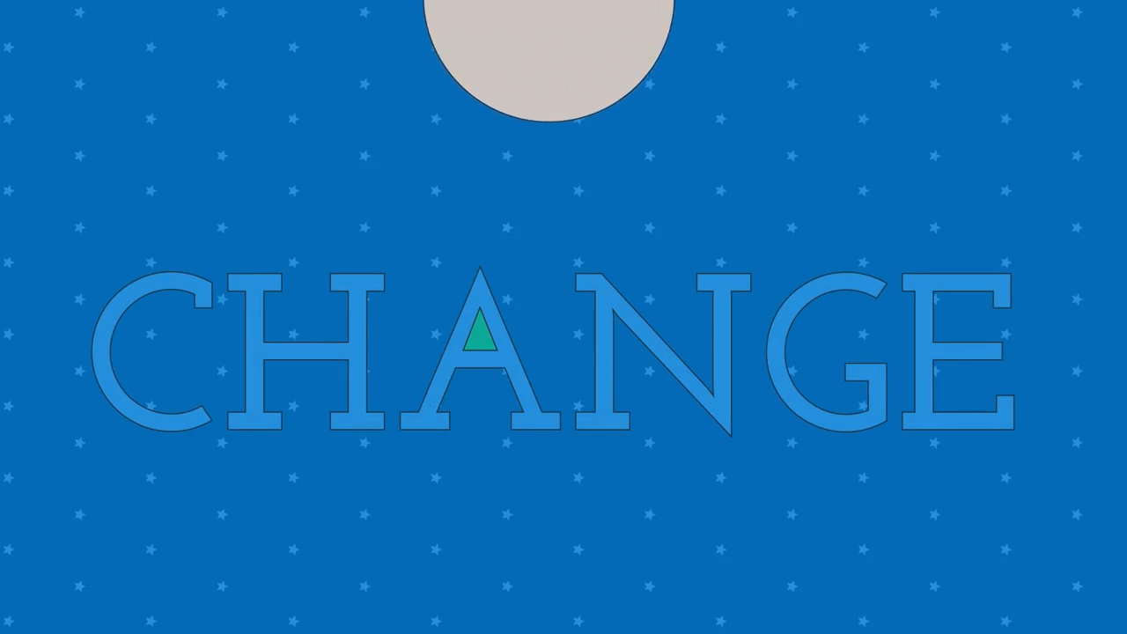
Stretch 2: Changing Reacting to Responding
Notes:
https://www.youtube.com/watch?v=ObDwK5rezHM&ab_channel=LearnFree

Slide 29


Stretch 2: Using Emotional Data to Make Better Choices
Think of a recent change that happened at work with results you felt were ‘bad.’
Note down the event and your emotions.
Think of a recent change that happened at work with results you felt were ‘good.’
Note down the event and your emotions.

Slide 30
Stretch 2: Using Emotional Data to Make Better Choices
Remembering the ‘bad’ change, describe the results in your notes. Include how you and other affected people reacted. How many people involved were accountable for their actions? Were there any traits or exchanges that you’d like to avoid going forward for better outcomes?
Now, remembering the ‘good’ change, describe the results in your notes. Include how you and other affected people responded. How many people involved were recognized for their actions? Were there any traits or exchanges that you’d like to reproduce going forward for more beneficial outcomes?

Slide 31
Stretch 3: Regroup, Reflect & Respond
Is it possible that every single emotion has a use? Are stressful emotions necessarily ‘bad’?
All emotions can help us process ‘the World’ or ‘Life.’ For example, sadness can help us process difficult times, and we would have no moral compass if we never felt shame or guilt. And joy can help us practice gratitude.
Let’s begin to move from ‘fight, fly or freeze’ to ‘regroup, reflect and respond.’
Here’s an example: Before responding to a tense email, take a pause and write one sentence about how you feel. Then choose your response.

Slide 32
Stretch 3: Regroup, Reflect & Respond
1. In which work situations do ‘amygdala hijacks’ commonly occur for you?
2. How might reminding yourself of the biological process that’s happening in your brain reduce the likelihood of an emotional reaction?
3. What are some of the benefits of recognizing and categorizing your emotional data?
4. How can you capitalize on that awareness?
5. Write two or three of these observations down and revisit them in one week.

Slide 33
Emotional Data Checklist (Post)
How much have you improved your ability to read emotional signals? Take this quiz again to gauge your new abilities.
Notes:
Shawna and Courtney, please use a sorting block for the following: Emotional Expressions - Visual and Verbal by Geography.xls

Slide 34
Emotional Data Checklist (Post) KEY
Identity | Physical Features | Vocal Features
Angry Brazilian | Frowning; direct eye contact; tense jaw, hand gestures | Raised, loud, passionate
Angry Chinese | Face neutral or slightly tight mouth | Quiet and firm, cold, clipped cadence
Confused Japanese | Nods politely, may ask questions later | Polite and respectful, pausing before speaking
Confused West African | Subtle gesture or questioning look, hesitant to interrupt | Quiet, polite tone.
Disappointed Phillipino | Sad eyes, polite smile | Quiet and resigned
Disappointed Western European | Frown and/or downcast eyes | Serious, somber tone
Disappointed South Asian | Sad expression, and a solemn look | Quiet and somber; a sigh
Loyal Israeli | Serious | Strong, maybe aggressive, very direct tone
Loyal Chinese | Unchanging expression, serious | Firm, respectful, and serious tone
Mentally Fatigued Mexican | Slumped posture, rubbing the eyes or temples | Sighs, a slow and tired voice
Mentally Fatigued South Korean | Tired smile, slightly slumped posture | Quiet and tired voice
Menatally Fatigued West African | Yawns, rubbing eyes, or a deep sigh. | Tired, slow, slightly slurred speech
Proud Brazillian | Open, beaming smile; posture is upright and confident, may 'high-five' people | Loud, enthusiastic, and confident tone
Proud Muslim Middle Easterner or Iranian | Broad smile, confident posture; can be very expressive | Warm, but not very assertive tone
Proud North American (East Coast) | Open, confident smile, upright posture; direct eye contact | Confident, assertive, enthusiastic tone
Stressed Colombian | Frowning; tense posture, quickened pace | Quick, sometimes shaky or frustrated tone
Stressed South Korean | Hunched back, hurried pace, serious expression | Hurried, often quiet, serious tone
Stressed Western European | Fidgeting, sighing, or a tired, strained look | Sighing, tense, maybe frustrated tone
Notes:
Shawna and Courtney, please use a sorting block for the following: Emotional Expressions - Visual and Verbal by Geography.xls

Slide 35
Revisiting Spark 1: Lived Experience
Let’s revisit the Japanese oil refinery story…
A few days later, after he had returned to Japan and calmed down, the advisor apologized to his counterpart and asked for forgiveness and an explanation of the travel mishap.
The Japanese man chuckled, “Well, you asked me for a work permit, not a visa, so I merely did what I was told. If you’d asked me for a visa as well, I could’ve gotten that for you, too.”
There was no enduring conflict between the Australian advisor and the Japanese administrator, however the emotional scars remained with the Japanese colleague and the Australian kept most of his antagonistic thoughts to himself for the duration of his mission.
As an observer, your author saw frustration, anger, shock, stoicism and empathy. The Japanese staffer had not let the data of emotions interfere with his logical work processes, and that is also a lesson to be learned.

Slide 36
Final Reflections…
How can we manifest the learning from our Stretch experiences in future? Try one (or both) of these follow-through activities:
Option 1: Reflect on a specific, challenging situation you currently face at work. Perhaps it’s a major change you must implement or a conversation you need to have that requires courage.
Now envision the emotions you might experience during the event or process and try to identify them (words aren’t always accurate, don’t worry!). Then write them down to revisit in future.
Afterwards, compare your estimations with the actual outcomes. How accurate were you?
Option 2: Complete the Emotional Regulation Pledge on the next slide, sign and date it and then share it with the Workplace Edge community
Notes:
Shawna and Courtney, similar to Liz’s request in her From Listener to Ally lesson, if there’s a way for the learner to share their pledge (and other commitments or thoughts) with the wider learning circle, please add that avenue to this page in the LMS.

Slide 37
My Emotional Regulation Pledge
Today I will try to identify (check one) □one or □ two emotions in myself at work and (check one) □ one or □ two emotions in others. These emotions were: __________ and _________. These emotions were (check one) :
□ suppressed and helped the collaborative effort.
□ left unchecked and harmed the collaborative effort.
Going forward, I will continue to be mindful of my own and others’ emotional states and try to identify this data to avoid knee-jerk reactions and find optimum outcomes as teammates and colleagues. In addition, I will share these realizations with my colleagues who are open and supportive of my efforts. Signed_____________
Date______________
Notes:
Shawna and Coutney, please add a way to allow learner to fill in the blanks with appropriate terms and strategies so they can track their progress. Also, ‘left unchecked’ is now in the glossary.
Thanks -n

Slide 38







In this Lesson We:
Appraised three of the human brain’s layers
Weighed how emotions affect us in our daily lives
Investigated recognizing emotional signals
Designed responses rather than allowing reactions to make personal accountability easier

